Slide 1
Risk Management in Commodities Companies
A new predictive stock price model incorporating features from webscraping SEC Filings
NYC Data Science Capstone Project

Slide 2
What Risk are these companies trying to manage?
The question we pose is to figure out how a commodities company’s strategy to hedge risk affects their stock prices.
The volatility of the commodities market makes this a serious question for both investors and academics studying Finance.
Our task is to use state-of-art Data Science techniques to
Collect Hedging positions of Oil/Gas Companies from the SEC’s website
Engineer a new feature indicating their Hedging Position
Build a quantitative model of the oil/gas companies’ stock prices with the new feature

Slide 3
Aren’t Hedges supposed to be on your lawn?
Hedging is a strategy that mitigates the amount of risk a company takes in entering the commodities market. There are several kinds of Hedges that a company can make, we specifically investigate Swaps and Collars as our main ‘instrument type.’
Swap: An agreement between two companies in order to protect themselves from volatility in the specific commodity market. Essentially it is an agreement to receive a certain number of goods for a fixed price, regardless of the market conditions.
Collar: Similar to a swap, but is a limit on both ends: if the price drops out for a certain commodity the company is protected against loss, but if the price skyrockets the company will not reap all of the benefits of the new price.

Slide 4
Data always has to come from somewhere...
Companies have a tendency to use their own system to record the data that the government mandates they file every quarter. We’ve been warned that the jobs we will have after bootcamp will require us to understand the way in which our company stores the data we want to utilize.
Now imagine having to deal with ten, twenty, thirty companies each with their own messy way of recording their data....
However, we have decided to move ahead anyways and ended up building an ecosystem in order to handle the input of raw data into a format that is usable with the Machine learning techniques that we acquired in the Bootcamp.

Slide 5
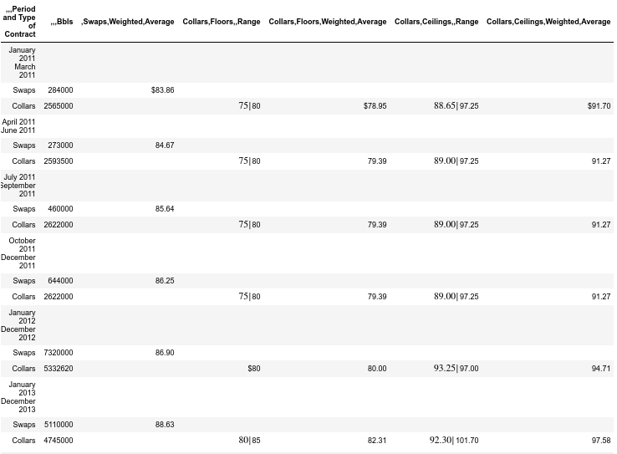
An Adventure through our Data Ecosystem!
Build a new library of Python functions to process the scraped data
So many functions we might as well call it a package!
Thinking in abstracted terms: set theory comes in handy here.
We start with RAW DATA, it’s as easy as 1, 2, 3!
Our table should have:
Maturity
Volume
Price
Product type (oil, gas)
Instrument type (swap, collar, put, etc)

Slide 6
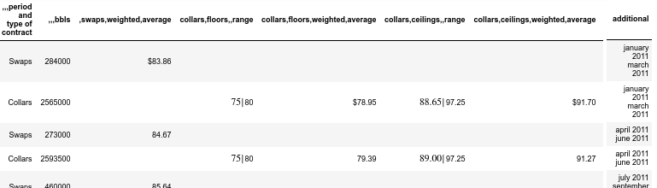
But how do we get there?
We implement a pipeline which executes the following steps:
Process Miscellaneous text data

Slide 7
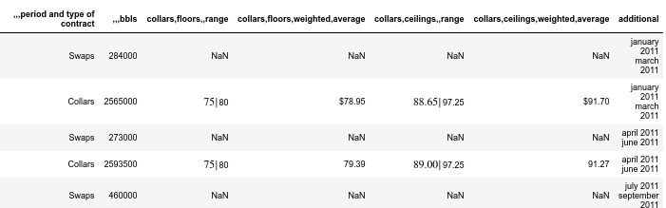
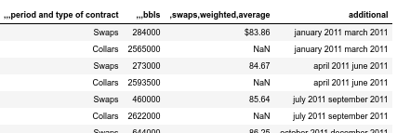
2a. Split the table to reduce the number of empty values in columns
Split on ‘collar’
Split on ‘swap’
We’ll follow the collar table through the rest of the ecosystem...
Notes:
We’ll follow the collar table for this part

Slide 8
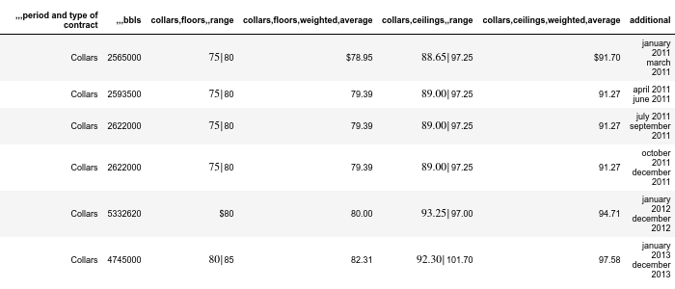
2b. And properly identify and remove now empty rows.

Slide 9
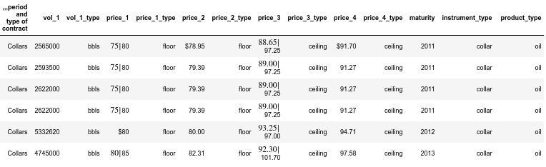
3. Utilize NLP to classify columns, retain relevant information, and remove unprocessed columns

Slide 10
Build a new database using various data sources
Scrape the hedge position data from Oil/Gas companies’ SEC filings (brand new!)
Production data for Oil/Gas companies (Bloomberg)
Collect oil and NG futures prices (EIA)
Assemble data on key macroeconomics indicators (Federal reserve)
Construct the key financial accounting variables for all oil/gas companies (companies financial statements)
Extract credit rating for all oil/gas companies (Moody’s)

Slide 11
Computing the new feature: Hedge Ratio
Get oil and natural gas production volume data from Bloomberg
Compute the annual ratio between the hedged volume and production volume for each product
Challenge: Different production period, date format, units...

Slide 12
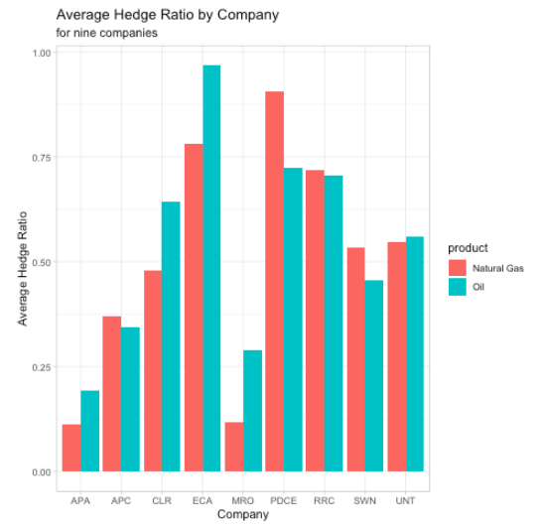
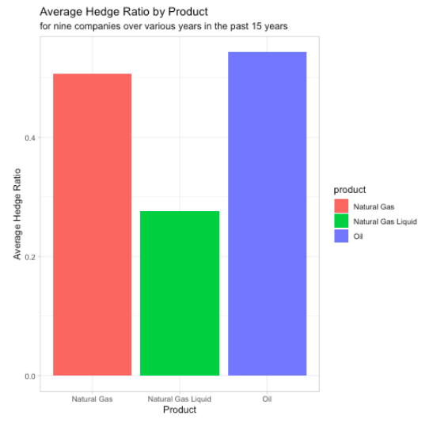
There is no difference in mean natural gas hedge ratio and mean oil hedge ratio (p = 0.4228).

Slide 13
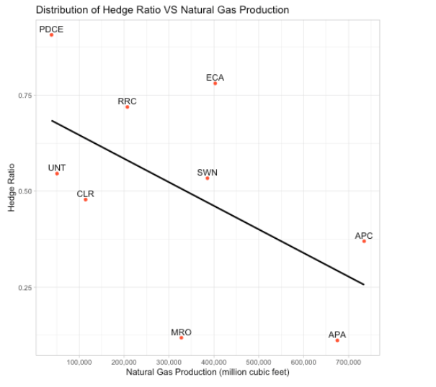
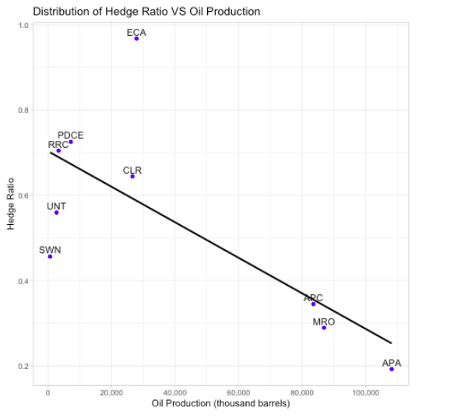
There is no statistically significant linear relationship between hedge ratio and natural gas production (p = 0.1127).
Hedge ratio for oil decreases by 0.0833 (95%CI: [0.0113, 0.155]) for every 20M barrels increment in oil production (p = 0.0291).

Slide 14
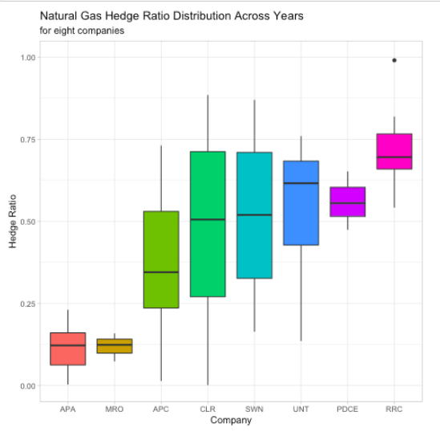
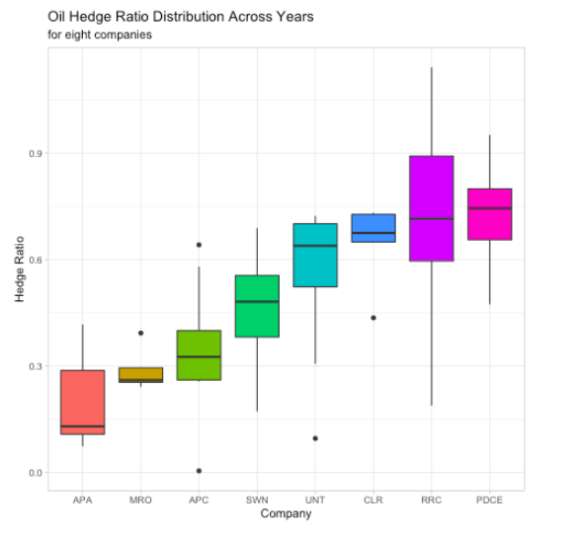

Slide 15
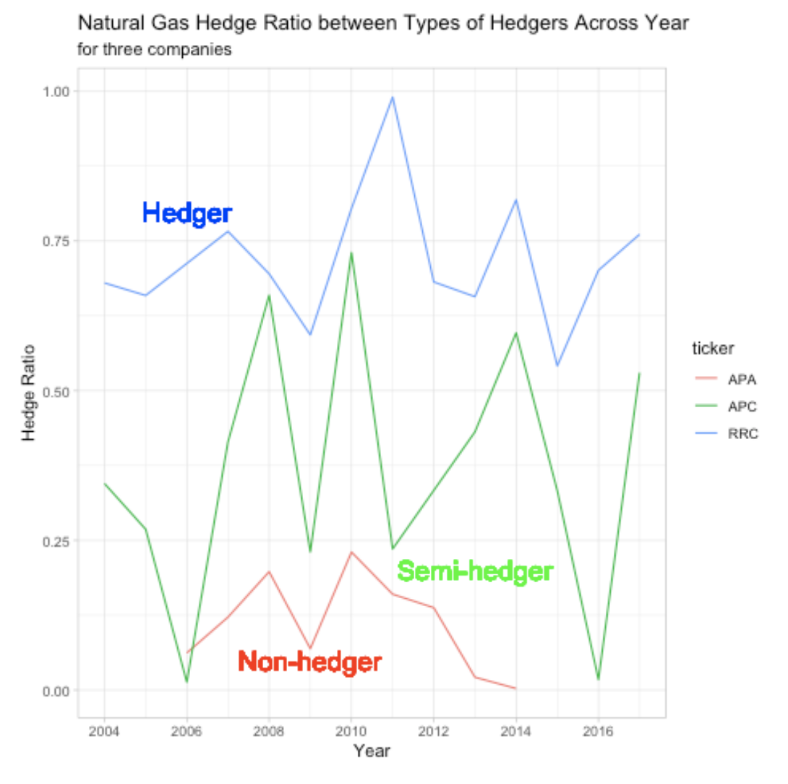
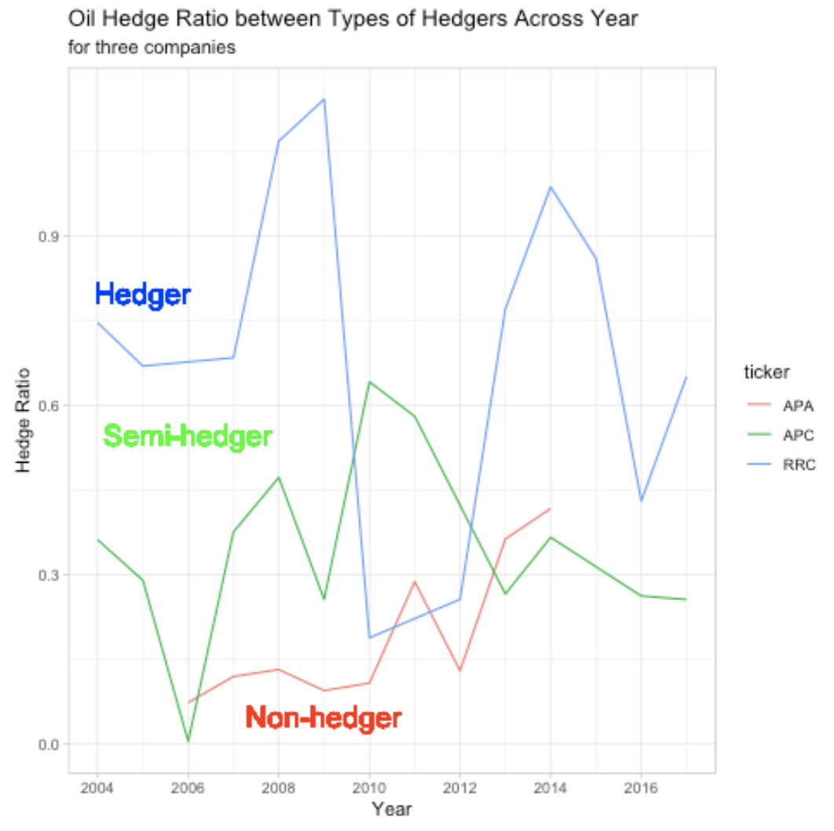

Slide 16
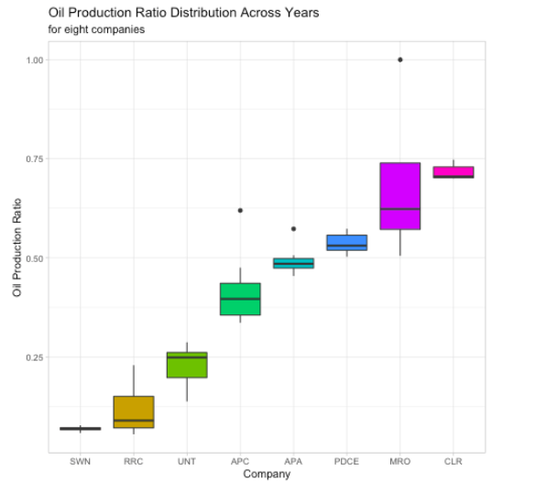
Natural Gas: Million Cubic Feet
Oil: Thousand Barrels
Use MBOED, which stands for Thousand Barrels Oil Equivalent
Potential additional feature

Slide 17
Divide and Conquer
We can divide up the companies in our dataset via grouping by hedge ratio and then further grouping by type of commodity company.
Three Hedging Classifications:
Hedger (Hedge Ratio > 0.5)
Semi-Hedger (Hedge Ratio between 0.1 and 0.5)
Non-Hedger (Hedge Ratio below 0.1)
Two Company Classifications:
Integrated (Company harvests and refines the commodity)
Independent (Company only harvests the commodity)
This leaves us with six distinct groups in which to observe the effect of the hedging ratio on our target variable, stock price return.

Slide 18
Below is the Financial Data(monthly frequency) used in addition to U.S SEC data:
Macroeconomic Data from FRED ST.Louis/OECD
Crude Oil and Natural Gas Futures Contract Prices from U.S EIA
Stock level financial accounting data

Slide 19
Modeling
Build a quantitative model to investigate to which the extent stock price returns of oil/gas companies can be explained by the commodity prices and the hedge-to-production ratio. Nested cross validation of the model is expected
R2 or RMSE using only macro variables + futures prices + stock-level financial accounting data, across group analysis (non-hedgers/semi-hedgers/hedgers)
Feature selection (explanatory model)
Construct a model which performs in-sample prediction for the stock price return and examine its performance.

Slide 20
Observations
1.(a) - Using the Lasso regularized regression model, we identified the influencers & non-influencers of the target variable stock price return.
Influencers: Non-influencers:
Stock Price - Rest of the Future contracts
Last month’s return
Crude Oil Future Contract 4
NG Future Contract 2
Note: Rest of the features are randomly influencing the target variable.

Slide 21
Moving Average Exogenous (MAX) Model
Motivation: Based on that last month’s Stock return has a strong impact on today’s stock return, considered an ARMAX model.
Dataset: Hedge_Monthly_Independent Companies (most samples)
Outline: In-Sample Prediction Model for stock return

Slide 22
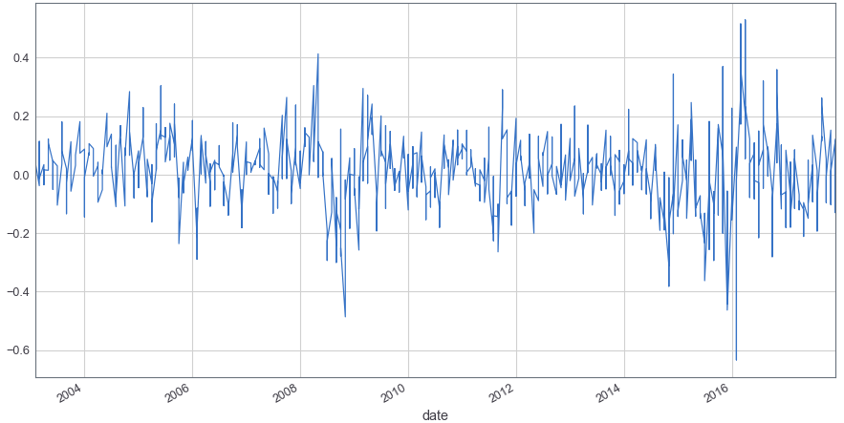
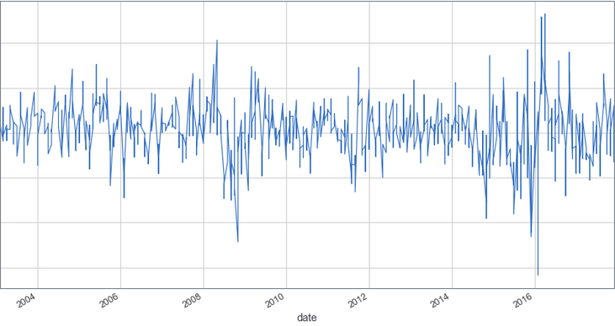
Stationarity Check for Hedge-Monthly-Independent return
Stationarity Condition
Trend Stationary
Constant Variance
- Constant Autocorrelation

Slide 23
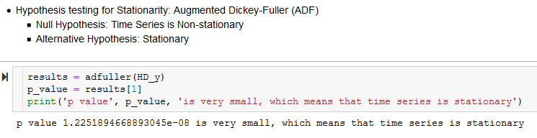
Augmented Dickey Fuller Test (ADF)

Slide 24
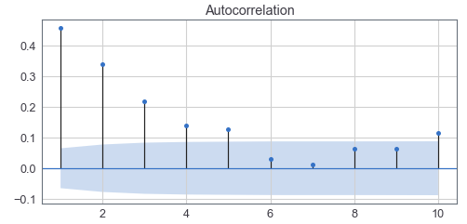
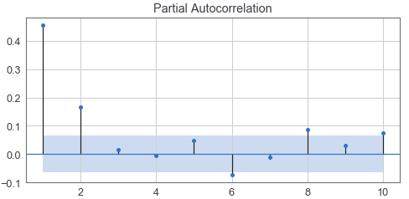
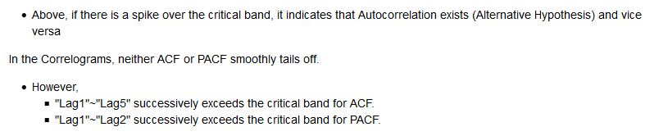
ACF, PACF correlogram to identify the potential orders

Slide 25
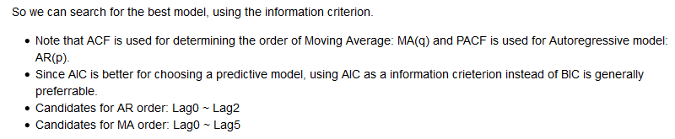
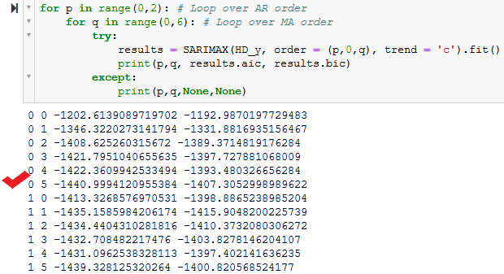
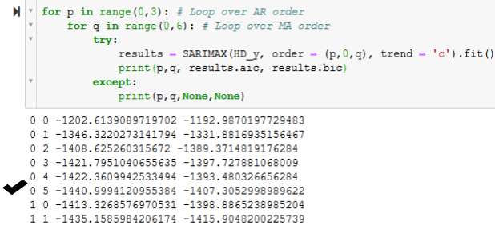

Slide 26

Comparison of MA(5) and MAX(5) with MAE
Exogenous Features: Features that were previously selected by the Lasso Model across the 4 combinations ( By Hedging-Ratio and Company Structure )
Stock Price
Crude Oil Future Contract 4 Price
Natural Gas Future Contract 2 Price

Slide 27
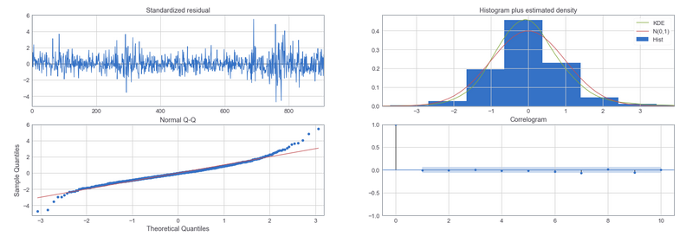
Model Diagnostics

Slide 28
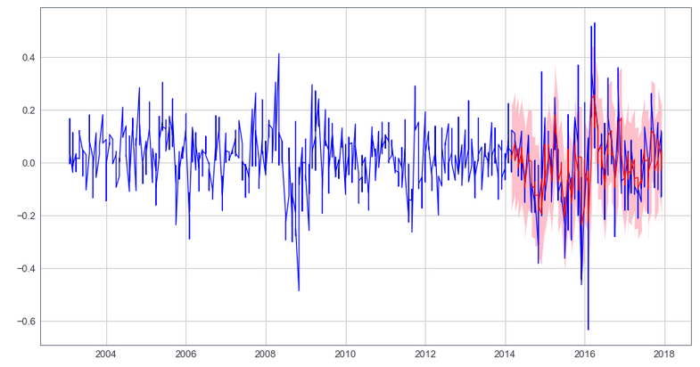
In-Sample Prediction Plot (10 period ahead)

Slide 29
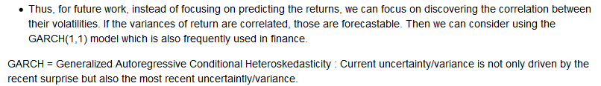
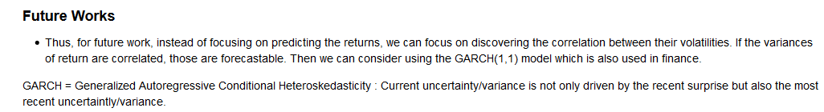
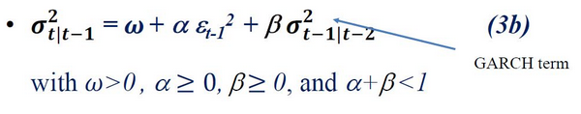
Future works for In-sample prediction model

Slide 30
Future Plans
Continued Analysis as per the outline
Abstract functions and wrap them into a useable package that will eventually be available on GitHub.
Create trading strategy that incorporates the hedging strategy of each company to indicate whether or not they will weather a disruption in the commodities market

